Slide 1
Internet of Things VII Sem Dept of CSE, NIT Raipur Unit II IoT Protocols IoT Access Technologies Topic Routing over Low Power and Lossy Networks
Dr. Veena Anand

Slide 2
LLN: Low-Power and Lossy Network
LLN: Low-Power and Lossy Network. Typically composed of many embedded devices with limited power, memory, and processing resources interconnected by a variety of links, such as IEEE 802.15.4 or low-power Wi-Fi.
There is a wide scope of application areas for LLNs, including industrial monitoring, building automation (heating, ventilation, and air conditioning (HVAC), llighting, access control, fire), connected home, health care, environmental monitoring, urban sensor networks, energy management, assets tracking, and refrigeration.”

Slide 3
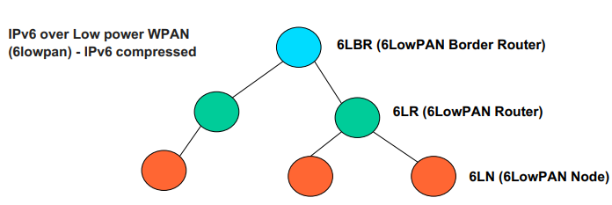
LLN: Low-Power and Lossy Network

Slide 4
RPL
RPL (Routing Protocol for Low-Power and Lossy Networks) is a routing protocol for wireless networks with low power consumption and generally susceptible to packet loss.
RPL is a ...
Distance Vector (DV) protocol
Source Routing Protocol
What is a Distance Vector (DV) protocol?
The term distance vector refers to the fact that the protocol manipulates vectors (arrays) of distances to other nodes in the network.

Slide 5
Distance Vector (DV) protocol
It is an Intra-domain routing protocol.
Requires that a router inform its neighbors of topology changes periodically.
Have less computational complexity and message overhead.
Distance-vector protocols are based on calculating the Direction and Distance to any link in a network.
− "Direction" usually means the next hop address and the exit interface.
− "Distance" is a measure of the cost to reach a certain node.

Slide 6
Distance Vector (DV) protocol
The least cost route between any two nodes is the route with minimum distance.
Each node maintains a vector (table) of minimum distance to every node.
The cost of reaching a destination is calculated using various route metrics.

Slide 7
Source Routing protocol?
Allows a sender of a packet to partially or completely specify the route the packet takes through the network.
Enables a node to discover all the possible routes to a host.

Slide 8
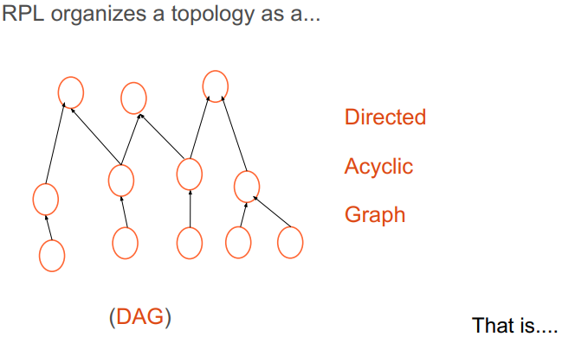
RPL

Slide 9
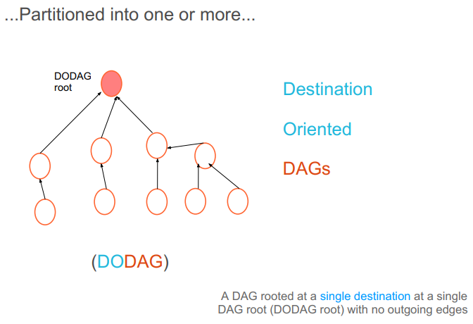
RPL

Slide 10
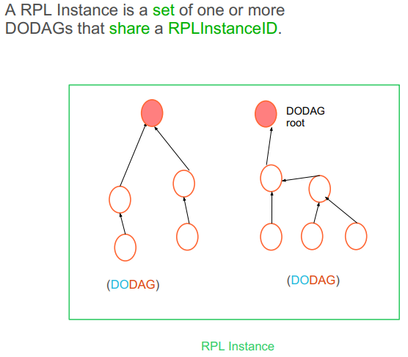
RPL
RPLInstanceID is a unique identifier within a network. DODAGs with the same RPLInstanceID share the same Function (OF) used to compute the position of node in the DODAG.

Slide 11
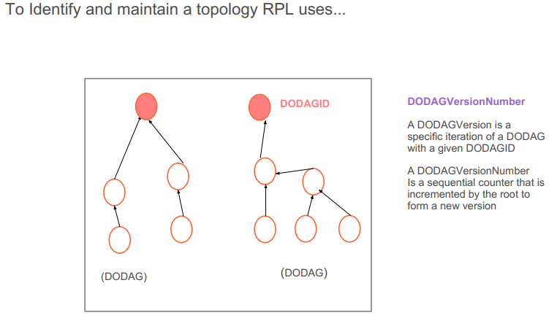
RPL

Slide 12
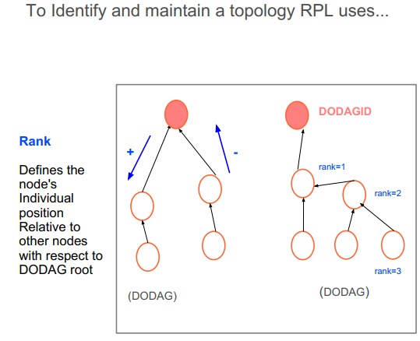
RPL

Slide 13
RPL
Grounded and Floating DODAG
A grounded DODAG offers connectivity to hosts that are required for satisfying the application goal
A floating DODAG is not expected to satisfy the goal, it only provides routes to nodes within the DODAG. e.g, provide interconnectivity during repair

Slide 14
RPL
Storing Mode-of Operation
A storing LLN keeps a downward routing table at each node.
traffic travels only as far as common parent.
storing mode limited by size of routing table
nodes with lower rank, have bigger tables!
protocol fails when any table is full.

Slide 15
RPL
Non Storing Mode-of Operation
A non-storing LLN sends all traffic to root. Root uses source routes to send traffic to leafs.
limited by ram of DODAG root/6LBR, but usually non-constrained device
requires more bits on wire, which often is more expensive (energywise) than more ram, or compute cycles.

Slide 16
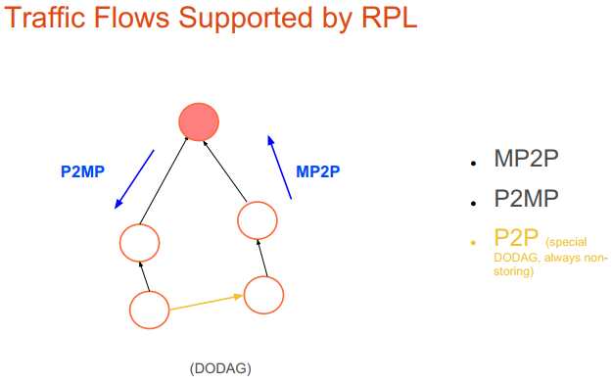
RPL

Slide 17
RPL
RPL Instance
A RPL Node may belong to multiple RPL Instances, and it may act as router in some and as a leaf in others.
Type: Local and Global
Control and Data packets has a RPLInstance field.

Slide 18

RPL
Global RPL Instance
Are coordinated, have one or more DODAGs, and are typically long-lived.
A global RPLInstanceID must be unique to the whole LLN.

Slide 19

RPL
Local RPL Instance
Are always a single DODAG whose singular root owns the corresponding DODAGID and allocates the local RPLInstanceID
D=0 in control messages
D is used in data packets to indicate whether the DODAGID is the source or Destination of the packet.
D=1 the dest. Address of the packet must be the DODAGID.

Slide 20
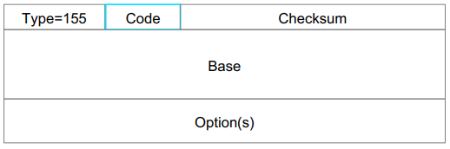
RPL
RPL Control messages are ICMPv6
Code: Identify the type of control message 0x00 → DODAG Information Solicitation (DIS) 0x01 → DODAG Information Object (DIO) 0x02 → Destination Advertisement Object (DAO) 0x03 → DAO-ACK

Slide 21
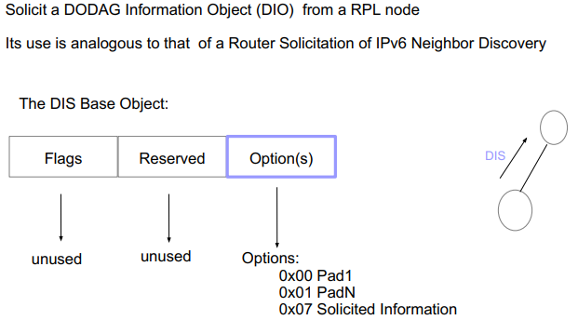
RPL
DODAG Information Solicitation (DIS)

Slide 22
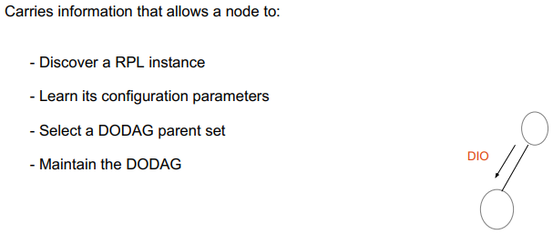
RPL
DODAG Information Object (DIO)

Slide 23
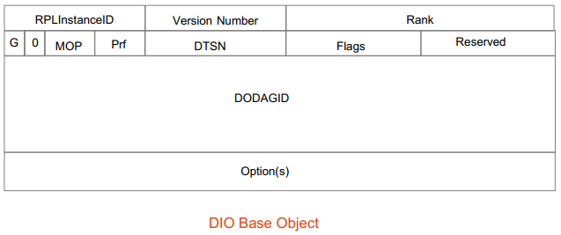
RPL
DODAG Information Object (DIO)

Slide 24
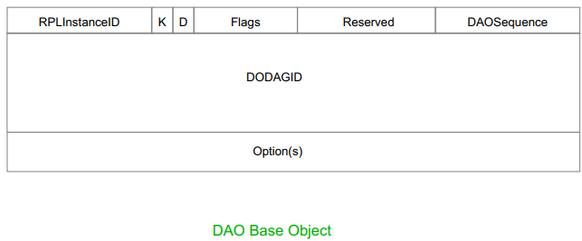
RPL
Destination Advertisement Object (DAO)

Slide 25
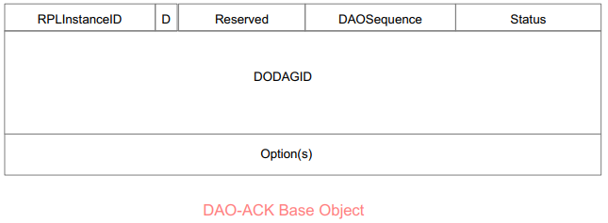
RPL
Destination Advertisement Object Acknowledgement (DAOACK)

Slide 26
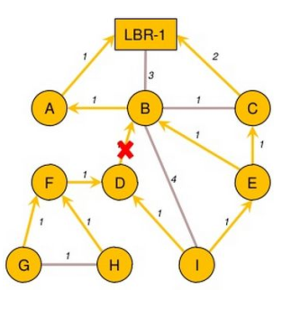
RPL
Mechanism for loop detection and DODAG Repair
Suppose link between nodes B and D is broken:
Node D type node B in its list.
Parent Node D is no longer any time in grounded DODAG Parent, so it will be the root of floating DAG itself.

Slide 27
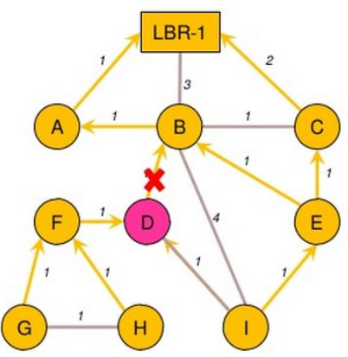
RPL
Mechanism for loop detection and DODAG Repair
Node D play DIO to notify change of sub-DAG
Node I has alternate parent E, so it does not leave the DAG of LBR-1.
Node I eliminates Node D Node from possible Parents list.

Slide 28
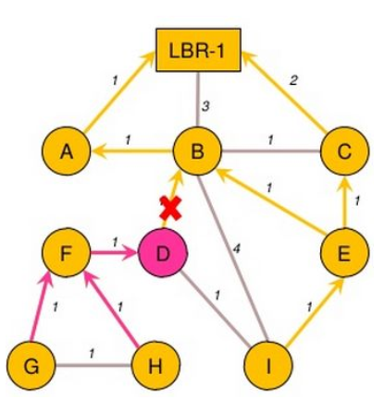
RPL
Mechanism for loop detection and DODAG Repair
Node F follows D node, as D leaves LBR-1 DAG: it has no choice
Node F hears DIO from D.
Node G and H also follow floating node F DAG.

Slide 29
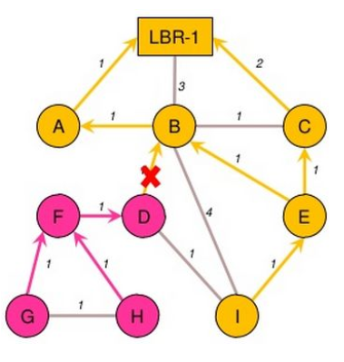
RPL
Mechanism for loop detection and DODAG Repair
Node I found DIO.
Node D listens to DIOs for opportunities to re-enter the last Grounded with depth 5 Node I.

Slide 30
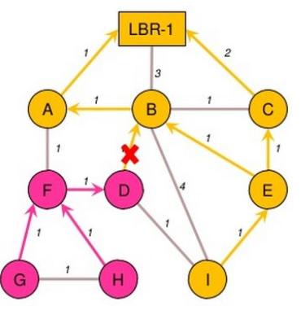
RPL
Mechanism for loop detection and DODAG Repair
Suppose link between A and F is set.
Node A send DIO.
Node F release notice Grounded DAG re-entry opportunities with depth 2 through node A DAG.
Hop Node F started with 1 cycle timer associated with the node A.

Slide 31
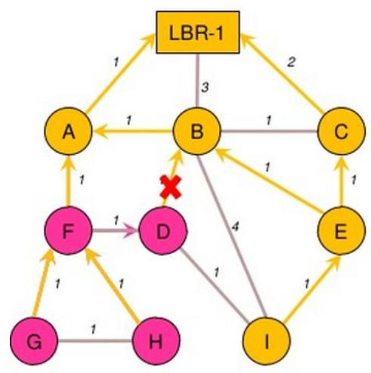
RPL
Mechanism for loop detection and DODAG Repair
DAG node F Timer goes off, issues DIS, receives DIO from A!
Node F Grounded DAG with depth 2 by adding the Parent A.
Node F send DIO with new rank/etc.
Node G and H join to the Grounded DODAG through F.

Slide 32
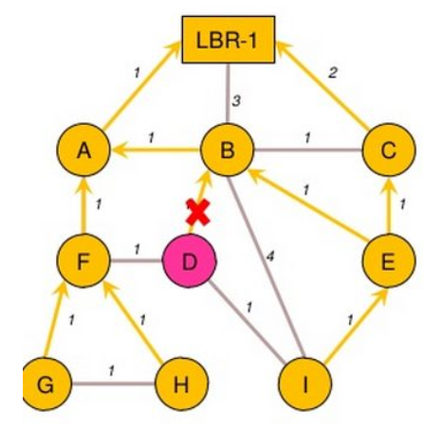
RPL
Mechanism for loop detection and DODAG Repair
Node D hears new DIO from F.
Node D start DAG Hop cycle timer with 2 attached to node F, while other timer is running DAG Hop with 4 cycles associated with the first node.

Slide 33
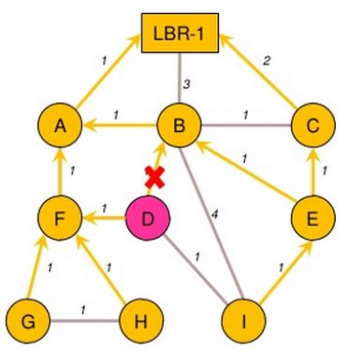
RPL
Mechanism for loop detection and DODAG Repair
DAG node D Hop timer with 2 cycles tend to end first.
Node D engaged with depth 3 Grounded.
DAG by adding Node F‘ parent.
End.

Slide 34
RPL
RPL adapted to Mobility
RPL was designed for static sensor networks
But, there are implementations that modify RPL and adap it to mobility environments, such as:
- mRPL - smart-HOP RPL, a hand-off mechanism within RPL
- MT-RPL - Mobility-Triggered RPL, a cross-layer protocol operating at layers 2 and 3.
- RPL-Vanet - RPL for vehicular environments.

Slide 35
RPL
Conclusion
RPL is the routing protocol for Low Power and Lossy Networks developed in ROLL IETF Working Group.
RPL Control Messages are used to build a topology.
Implementations were developed and help to identify features to improve the protocol.

